Slide 1


Data-Driven Storytelling Presentation:
Sales Performance Dashboard: 2017-2021
Strategic Insights into Account Sales and Growth Opportunities

Slide 2
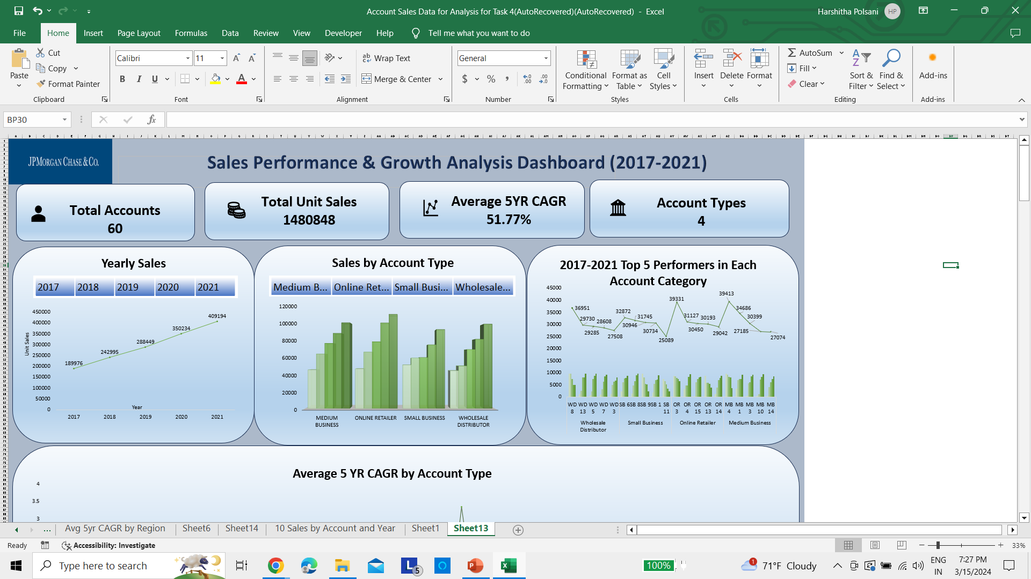
Overview of Sales Growth – A Consistent Increase in Yearly Sales
The data illustrates a consistent increase in sales over the five-year period, culminating in surpassing the 409,194-unit mark in 2021. This signifies a strong upward trend in the company's sales performance.
Figure shows Line graph illustrating the annual sales increase from 2017 to 2021.

Slide 3
Analysis of Sales by Account Type
The analysis of sales by account type reveals the strengths and potential areas for growth within the company's portfolio.
It highlights that certain account types, such as Medium Business and Online Retailer, consistently outperform others.
Figure shows Bar chart displaying sales distribution by account type.

Slide 4
Highlighting Top Performers by Account Category
Medium Business accounts showcase good performance, with the leading account marking the highest sales at 39,413 units from 2017-2021.
The chart showing the top 5 performers' CAGR in each account category

Slide 5
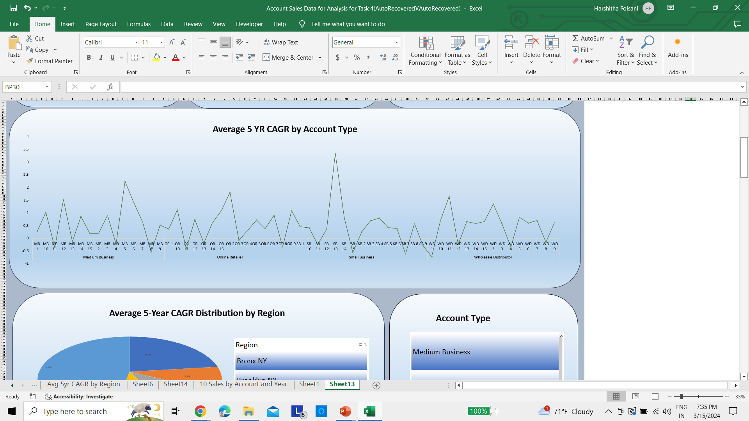
Average 5YR CAGR by Account Type
The graph provides a clear depiction of growth trends over the past five years, revealing both high-achieving accounts and those with room for improvement. Leaders like MB5, with a CAGR of 2.25, and OR2, at 1.81, SB13 at 3.34 demonstrate the success of effective sales strategies and market alignment. In contrast, accounts like MB11 and OR11 show negative growth, prompting a need for reevaluation of tactics and client engagement in these areas. This data empowers decision-makers to allocate resources wisely, bolstering high performers and revitalizing lagging accounts.

Slide 6
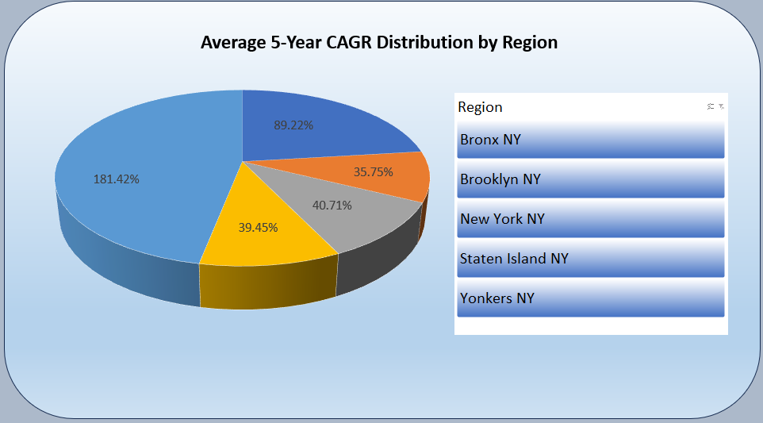
Regional Analysis of 5YR CAGR Distribution
The regional analysis highlights Yonkers NY as the leader with a staggering 181.42% 5-year CAGR, followed closely by Bronx NY.
This insight enables us to allocate resources strategically to regions with high growth potential and to understand regional market dynamics more deeply.
Pie chart showing the CAGR distribution by region.

Slide 7
Summary
The sales growth trajectory from 2017 to 2021 showcases a resilient market presence, climaxing at over 409,194 units in 2021. This momentum underscores the company’s robust sales strategies and customer acquisition efforts.
Dissecting the performance by account type has unveiled pivotal insights—Medium Businesses and Online Retailers have consistently led the sales figures, highlighting the importance of digital platforms and the B2B sector in current market trends.
An in-depth look at the Compound Annual Growth Rate (CAGR) across account categories points to standout performers like MB5, OR2, and particularly SB13. These accounts, with their exceptional growth rates, serve as benchmarks for strategic planning and resource allocation.
However, it’s critical to address the underperforming segments identified by negative CAGR values in accounts such as MB11 and OR11. Revitalizing strategies and client engagement approaches in these areas may prove crucial for balanced portfolio growth.
The regional CAGR distribution paints a promising picture of untapped potential in Yonkers NY and Bronx NY, inviting a strategic review of regional marketing initiatives to replicate this success in other locales.

Slide 8
Summary
The Analysis reveals a clear course for future success. By drawing on the strengths of our best-performing accounts and reinvigorating areas that are lagging, we can create a more dynamic and responsive sales approach. Focusing on digital marketing, customer relationships, and product innovation will place us at the forefront of growth. It's time to harness these insights and turn them into actionable strategies that will lead us into a period of sustained expansion and market leadership.

